Slide 1
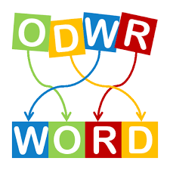
MINI PROJECT
JUMBLED WORD GAME
AJAY KUMAR
1602-20-737-002
Raj Charan Reddy
1602-20-737-029
Irfan
1602-20-737-052

Slide 2
ABSTRACT
This is a GUI application. The user will have multiple categories of words to choose. Based on the category they select the jumbled words will be displayed for which they will have to type their answers in the entry box. On submitting the answer, they will get either 5 points or 0 points added to their current score. In addition, the pop- up shows if the answer is correct or not. They can change their word if they want to. And if they opt viewing the answer, their score will be reduced by 5. It displays “not
enough points” if the score is not greater than 5. Furthermore, the user can go back to choose another category of words at any point of time.

Slide 3
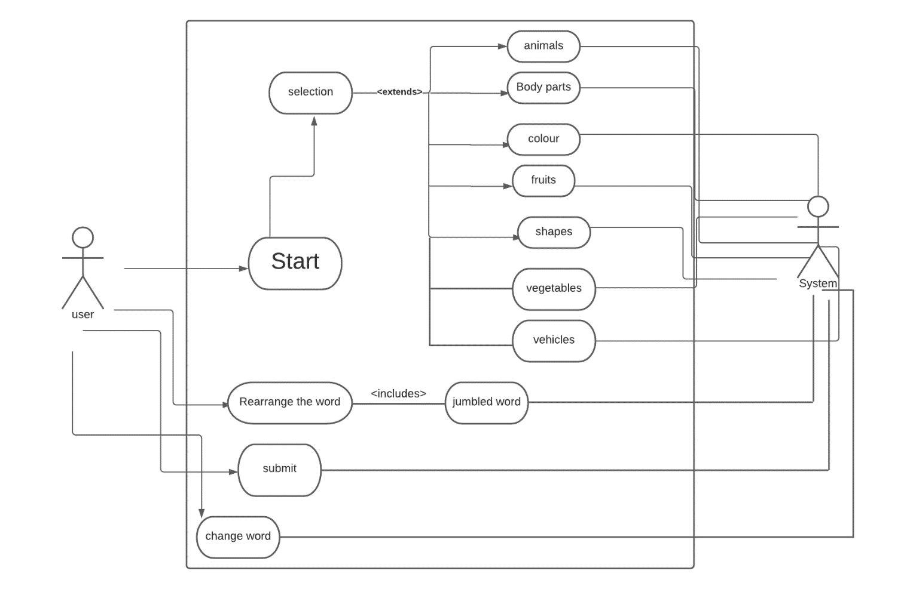
USE CASE DIAGRAM

Slide 4
TECHNOLOGY USED:
Hardware Requirements:
Minimum Ram required: 512 mb
Minimum Disk Space required: 50 mb
Processor: core i3 or above
Software Requirements:
Python 3.9 Latest Build
Windows Desktop version (7/8/10/11)
PyCharm IDE for windows devices

Slide 5
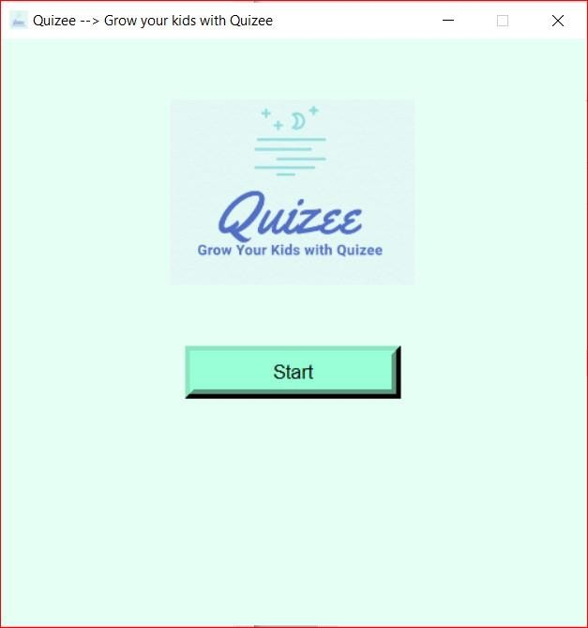
outputs

Slide 6
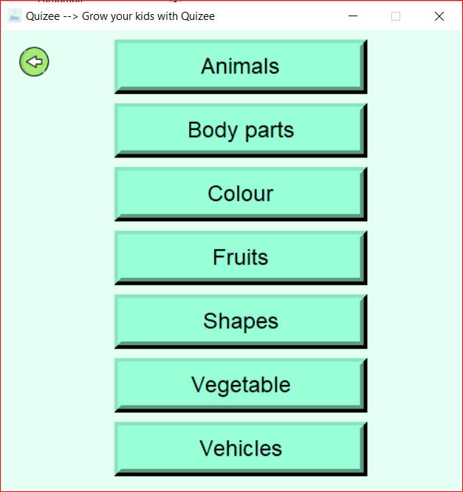

Slide 7
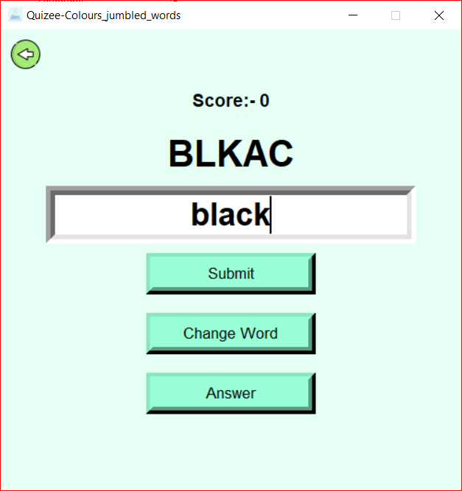
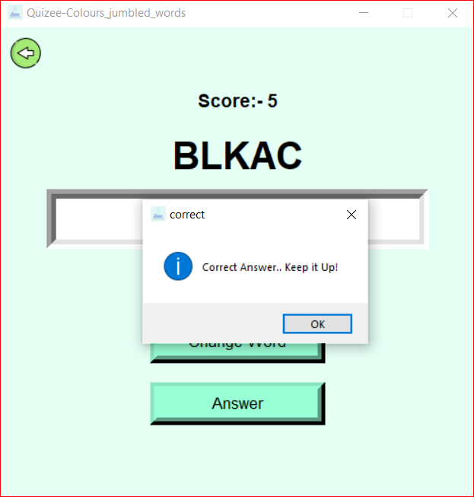

Slide 8
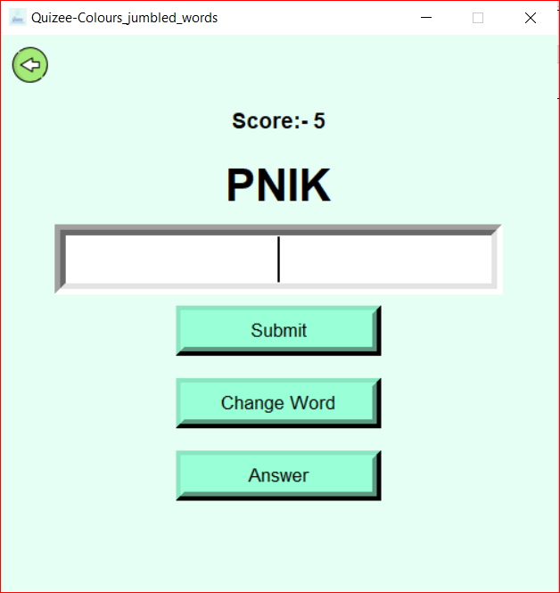
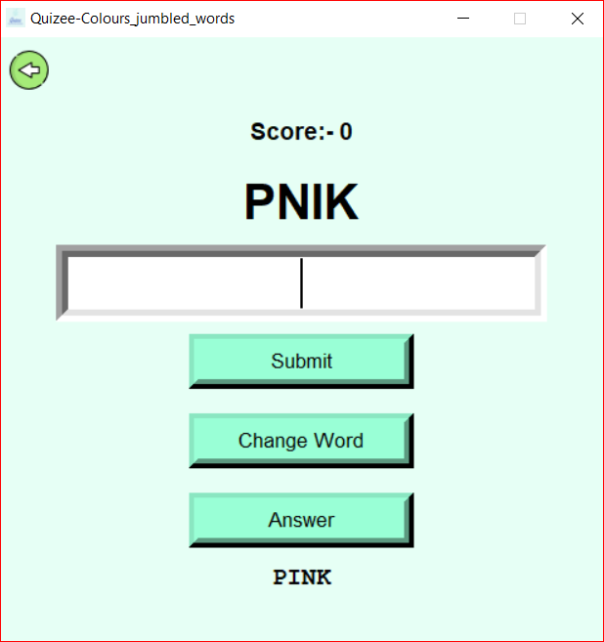

Slide 9
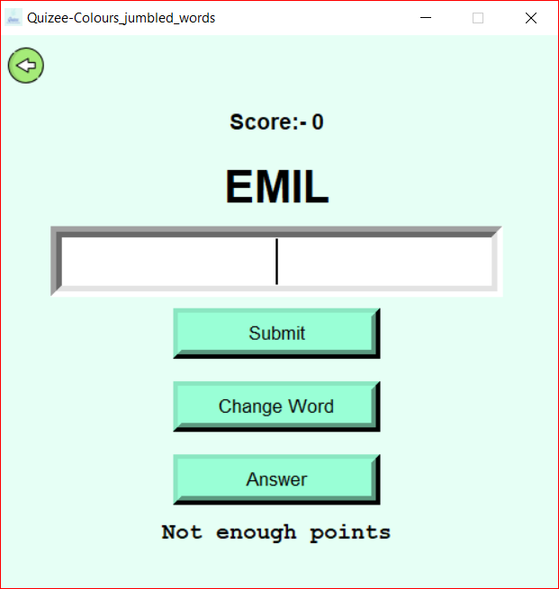
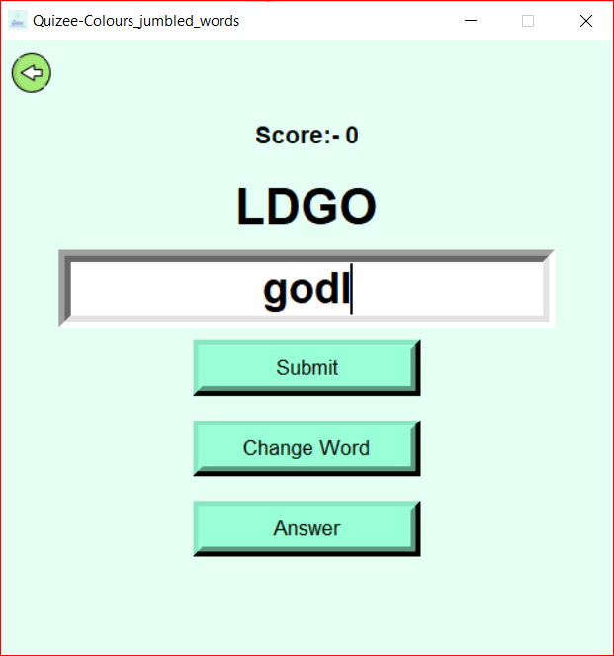

Slide 10
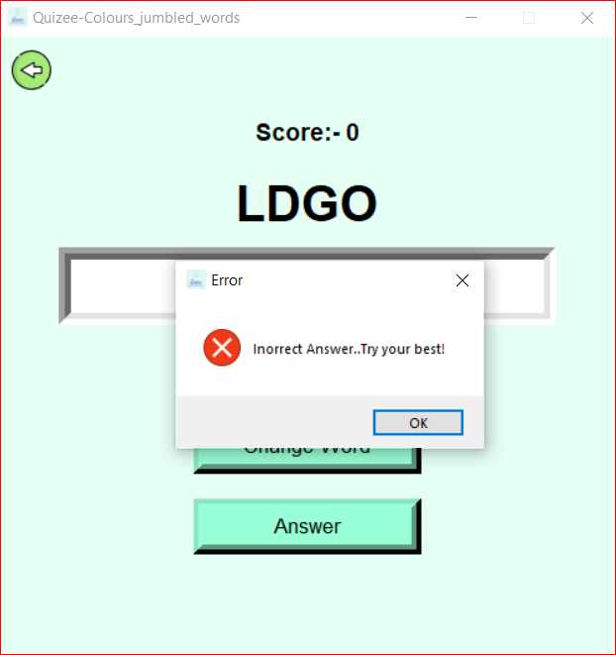

Slide 11

CONCLUSION AND FUTURE WORK:
To conclude, this game lets children have fun while also increasing their IQ. We wish to carry this spirit and work on many more projects in future.
We gained so much information about how various modules work and how various packages are used to implement GUI.
To conclude, this game lets childrenhave fun. We wish to carry this spirit and work on many more projects in future.

Slide 12
THANK YOU
Level Extension
Improve Graphical Representation
Introduce new game features
Take user responses through website and produce web rank list
FUTURE SCOPE:

